Slide 1

NBA
MY HOBBY
主讲人：鲁博

Slide 2


I love basketball ,I also love NBA
The National Basketball Association (NBA) is the pre-eminent men's professional basketball league in North America. It consists of thirty franchised member clubs, of which twenty-nine are located in the United States and one in Canada. It is an active member of USA Basketball (USAB), which is recognized by the International Basketball Federation as the National Governing Body (NGB) for basketball in the United States.

Slide 3
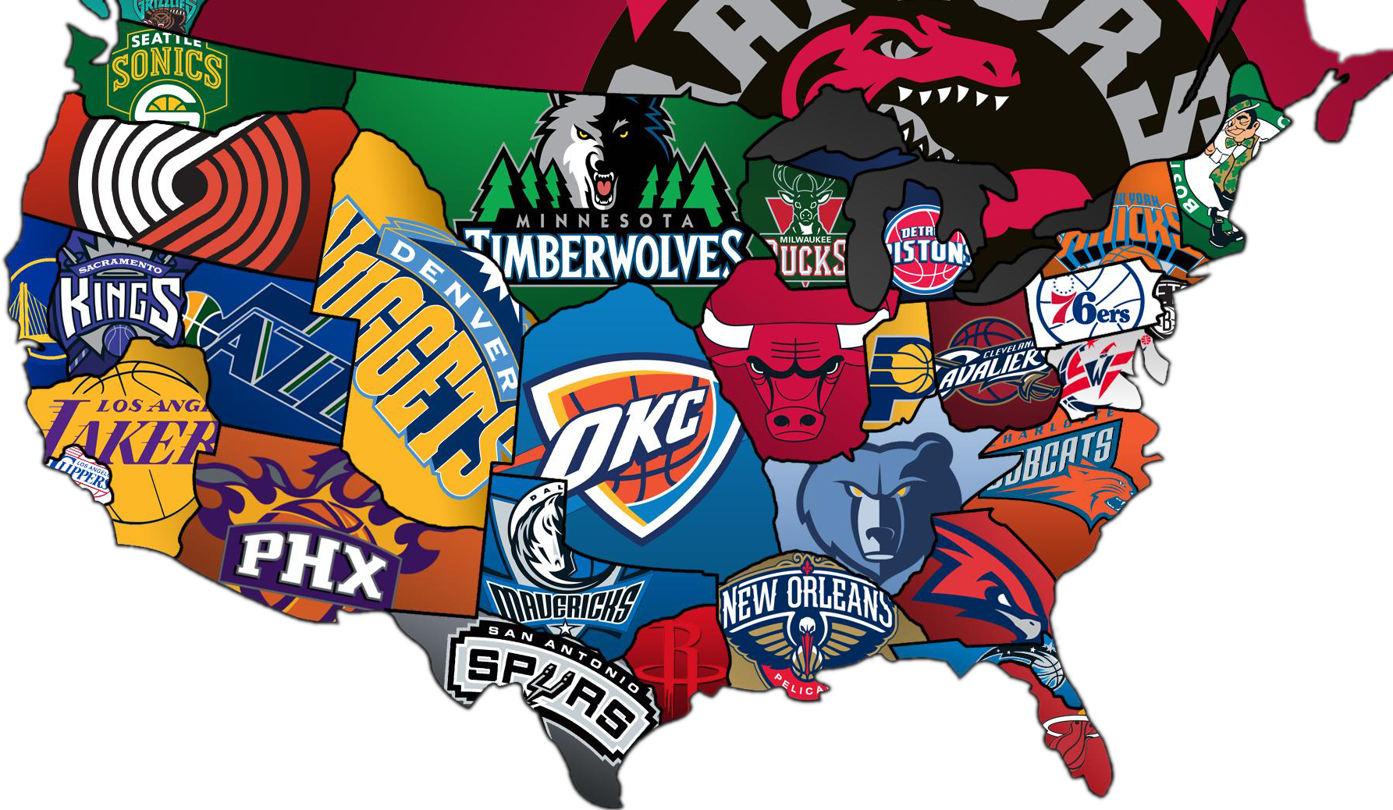
The 30 teams in NBA are divided to two alliances(联盟)---east and west alliance ,each has 15 teams .East alliance can be divided to Central ,Southeast and Atlantic divisions. West alliance is divided to Northwest , Southwest and Pacific division .

Slide 4




The NBA competition is divided into two parts ,one is Regular Season ,another is Playoffs Season .As a result ,every team will try its best to competitive the Final Games

Slide 5


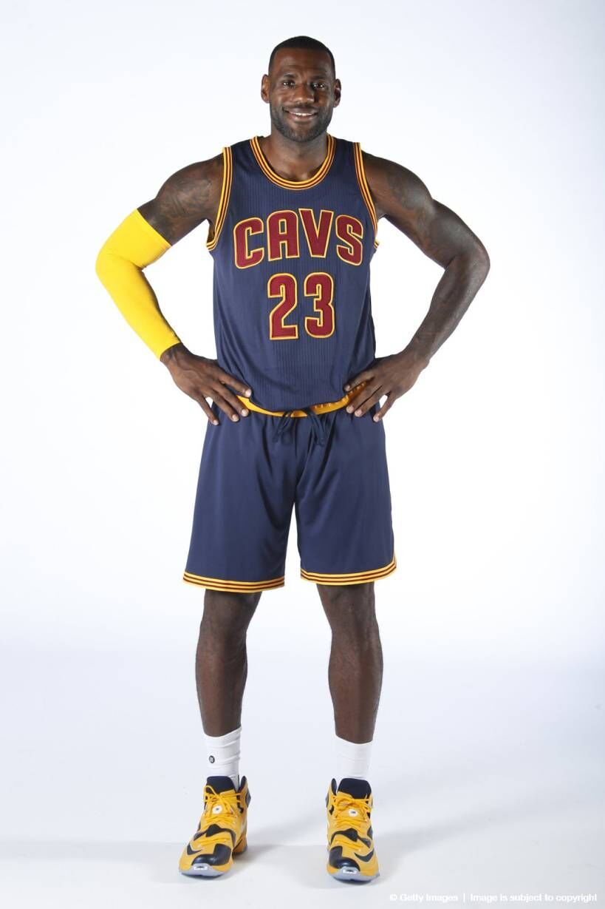
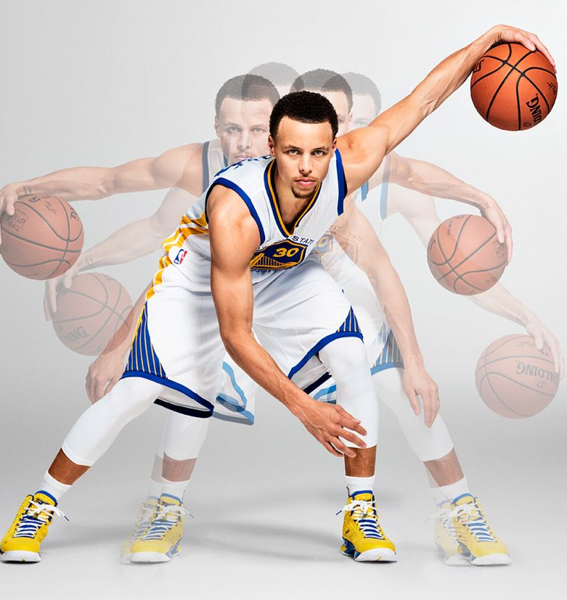

Slide 6

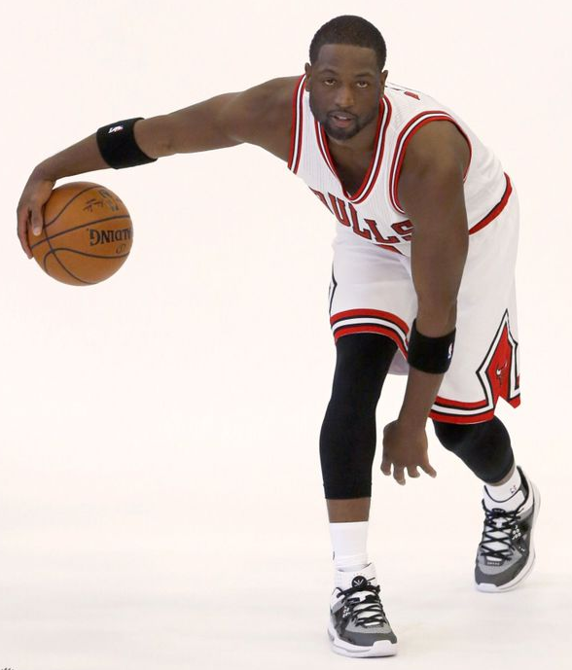
Dwyane Wade
Born: 17 January 1982
Birthplace: Chicago
Best Known As: Miami Heat guard called "Flash" and "D-Wade"

Slide 7
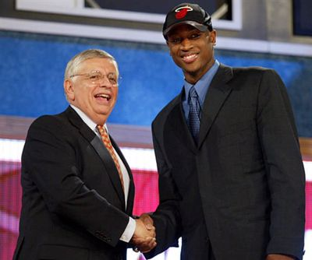
After college season ,he became the fifth overall pick in the 2003 NBA draft.

Slide 8
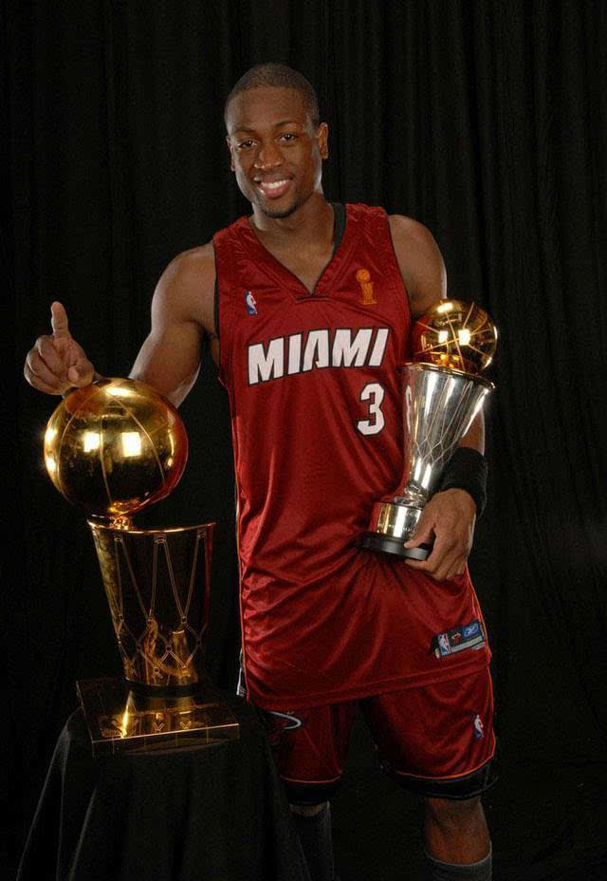
After only three years in the NBA, guard Dwyane Wade leaded the Miami Heat to the 2006 championship．And he won the final MVP！

Slide 9
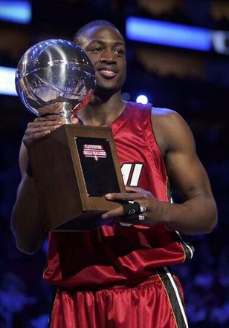
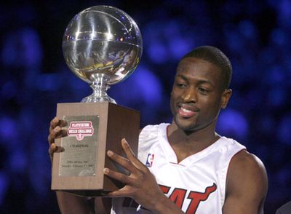
Wade won the NBA all-star skills challenge champion in 2006and 2007and the all-star game MVP in2010!

Slide 10
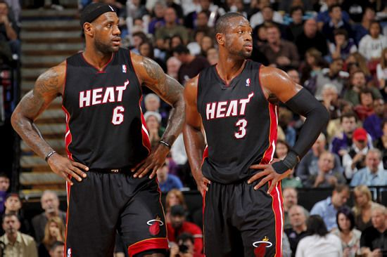
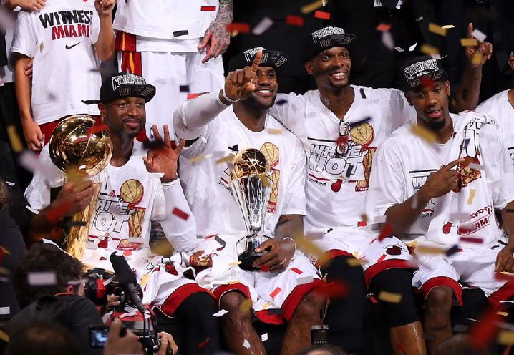
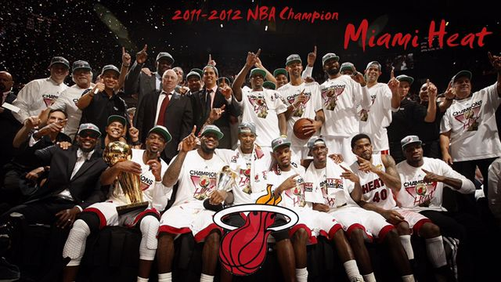
In the 2010-2011 season,Lebron James joined the team.Then they leaded the Miami Heat to win two championships.

Slide 11
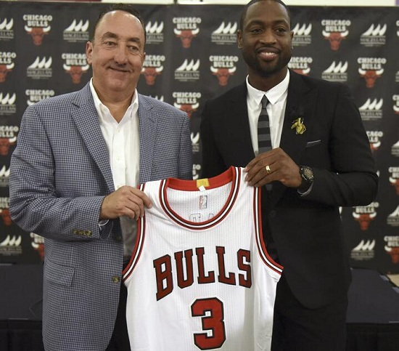
This summer, Wade left the heat, and joined the hometown team - Chicago bulls

Slide 12
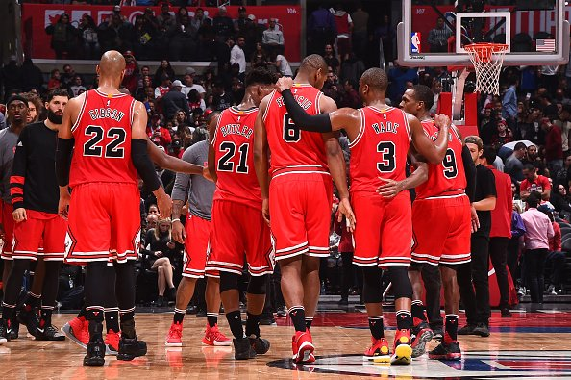
Let's go ,BULLS!

